Slide 1
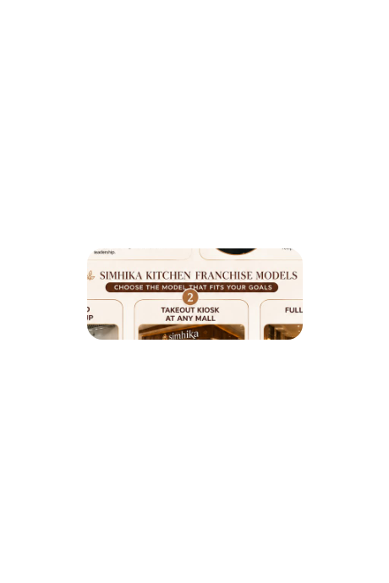






Franchise Partnership Program
Nourishing Lives, One Meal at a Time • High-Margin, Irresistible Regional Indian Thalis, Unlimited Meals, Daily Tiffins & Event Catering

Slide 2

The Affordable Indian Food Boom
Unlocking the Philippine appetite for bold, fragrant, and unlimited dining through standardized regional Indian comfort cuisine.

Slide 3

Market Void vs. The Simhika Edge
The Philippine Market Void
The Simhika Solution
Overpriced Fine Dining: Metro Manila Indian spots charge ₱600–₱1,200 per dish, locking out mainstream Filipino workers and students.
The ₱199 Price Revolution: Complete 4-dish regional thalis priced at ₱180–₱220, directly competing with food courts.
Zero Quick-Lunch Combos: BPO professionals and office workers have no access to affordable, fast, pre-portioned ethnic lunch sets.
Filipino Cultural Synergy: Leveraging the country's passion for "Unli-Rice & Gravy" to drive massive lunchtime queues.
Inconsistent Street Stalls: The few budget curry stalls suffer from erratic hygiene, unstandardized recipes, and unreliable supply.
4 Resilient Cash Streams: Seamlessly integrating dine-in foot traffic with prepaid tiffins and high-ticket event catering.

Slide 4
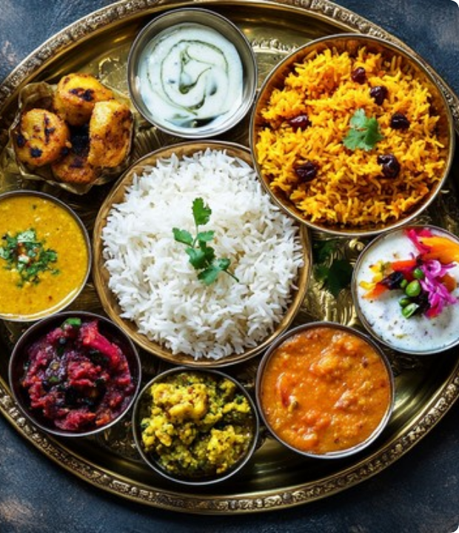
Pan-India Regional Thali Heritage
Authentic Flavors, Standardized Prep
Simhika Kitchen brings India's vibrant regional heritage to the Philippines through chef-crafted, high-velocity thalis. From rich North Indian gravies to light South Indian stews, every platter offers clean ingredients, low oil, and pure homestyle taste.
Our standardized mother gravies enable fast 3-minute assembly with zero master chef dependency.

Slide 5






The "Unlimited Meals" Advantage
The Unli-Rice Habit
Sub-30% Food Cost
Viral Word-of-Mouth
Filipino food culture thrives on unlimited rice and sauces. Simhika adapts this proven consumer behavior to aromatic Basmati rice and rich Indian curries.
Rice, lentils, and base gravies carry exceptionally low ingredient costs. Unlimited refills delight hungry diners while safeguarding 68%+ gross margins.
Unlimited authentic Indian meals starting at just ₱299 generate immediate TikTok and Facebook virality, packing seats with zero advertising spend.

Slide 6






Four Lucrative Revenue Streams
Dine-In & Express
Monthly Tiffins
Fast-turnover lunch trays and experiential evening dining.
Prepaid 20-day lunch deliveries to BPO and expat towers.
Integrated Cash Channels
Corporate Catering
Delivery Apps
Diversified income streams ensuring consistent daily profitability from breakfast to late night.
Bulk event packages for embassies, townhalls, and parties.
Optimized combos on GrabFood and Foodpanda platforms.

Slide 7
Three Scalable Franchise Models
Franchise Model | Capital Outlay | Target Monthly Sales | Projected Net ROI | Operational Focus
1. Cloud Kitchen Setup | ₱500,000 | ₱200,000+ | 30% per annum | Low-overhead commissary; BPO tiffin contracts & GrabFood/Foodpanda deliveries.
2. Mall Takeout Kiosk | ₱1,000,000 | ₱500,000+ | 20% – 30% per annum | High-traffic mall food courts; rapid grab-and-go express mini-thali lunch boxes.
3. Full Restaurant Setup | ₱1,500,000 | ₱1,000,000+ | 25% per annum | Full experiential dining, unlimited thali feasts, family banquets & bulk catering.

Slide 8
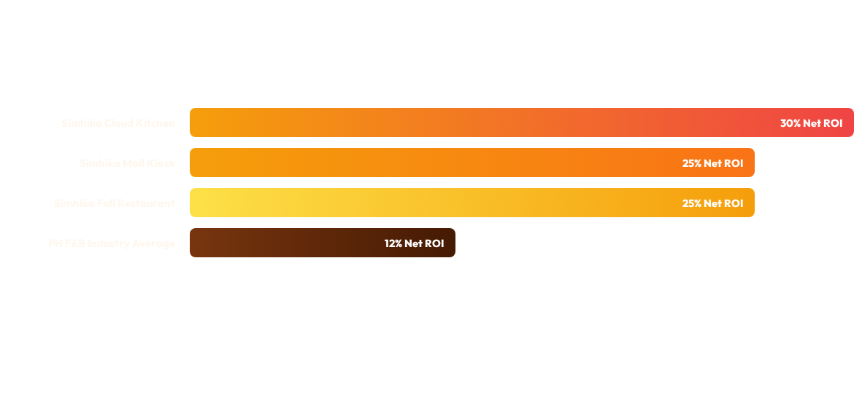
Projected Annual ROI Breakdown
Simhika Kitchen's standardized base gravies, prepaid tiffin subscriptions, and optimized food cost ensure franchise payback within 12 to 16 months—more than double the industry benchmark.

Slide 9


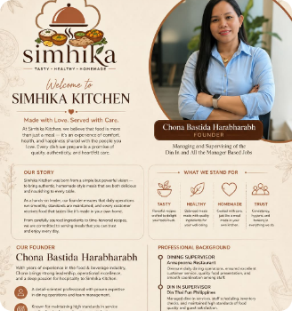

Meet Our Visionary Founder
Decades of Hospitality & Operations Mastery
Proven track record leading top-tier Philippine and international dining institutions:
•
Dining Supervisor at Annapoorna Restaurant: Directed floor coordination, banquet staging, customer relations, and authentic dining standards.
•
Dine-In Supervisor at Din Tai Fung Philippines: Mastered Michelin-grade operational speed, stringent cleanliness, shift scheduling, and inventory controls.
•
Hands-On Franchise Operations Lead: Personally oversees unit onboarding, standard operating procedures (SOPs), and quality assurance for every partner store.
"Made with Love. Served with Care. We believe food is an experience of comfort, health, and genuine happiness shared with the people you love."
Chona Bastida Harabharabh
Founder & Operations Lead

Slide 10
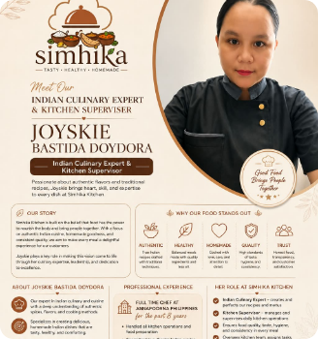

Indian Master Chef Spotlight
8+ Years Commercial Indian Kitchen Leadership
The culinary authority engineering Simhika Kitchen's standardized spice blends and signature regional recipes:
•
Full-Time Chef at Annapoorna Philippines (Past 8 Years): Led high-capacity commercial kitchen brigades, traditional masala grinding, and regional curry operations.
•
Proprietary Base Gravy System: Engineered turnkey mother gravies allowing local line cooks to execute 100% authentic flavors without hiring expensive specialized chefs.
•
Zero-Wastage Kitchen Controls: Implements strict batch-cooking protocols and inventory optimization to safeguard unit-level profit margins.
"Good Food Brings People Together. We craft authentic Indian dishes with healthy ingredients, less oil, and uncompromised home-style integrity."
Joyskie Bastida Doydora
Indian Culinary Expert & Supervisor

Slide 11
Complete Turnkey Partner Support
Zero-Chef Dependency: Proprietary pre-measured spices and base gravy pouches ensure consistent, authentic taste with standard kitchen staff.
Centralized Supply Chain: Direct wholesale pricing on Basmati rice, premium lentils, Indian spices, and branded eco-friendly thali packaging.
Aggregator & Digital Launch: Turnkey onboarding on GrabFood, Foodpanda, and Google Business, backed by localized social media advertising.
Comprehensive 14-Day Staff Bootcamp: Thorough on-site training covering portion speed, food safety protocols, and point-of-sale customer service.

Slide 12
Join the Simhika Franchise Family
Invest Today. Earn Tomorrow. Let's Build Your Profitable Future!
Partner with the premier pioneer of affordable, unlimited Indian dining in the Philippines. Together, let's serve wholesome, authentic comfort food to millions of diners.
franchise@simhikakitchen.ph
Inquire via WhatsApp / Mobile
Metro Manila, Philippines

Slide 13

Image Sources
https://images.stockcake.com/public/3/8/1/38101927-082e-4b8c-bb62-a7ebacb9b5dd_large/indian-feast-spread-stockcake.jpg
Source: stockcake.com

